Slide 1

AUTOMATED CENTRALISED FACE MASK MONITORING SYSTEM
-Team IIESTS_2
Sourav Gupta
Hanuman
Ankit Kumar
Sourav Gupta

Slide 2




TIMELINES OF PRESENTATION
Introduction
Objectives
Hardware Specifications
Proposed Approach
Applications

Slide 3

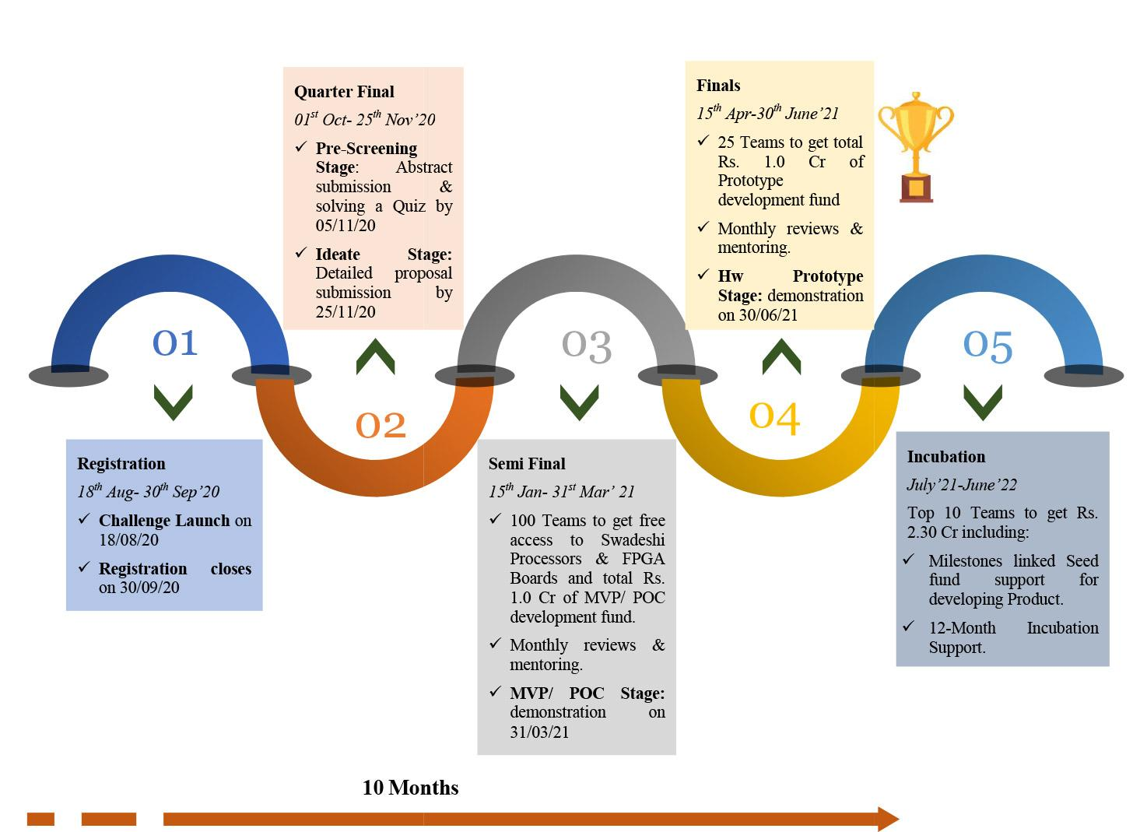
Introduction

Slide 4





Project Introduction
Wearing face masks have become an important part of our daily routine
To help the world with our small contributions we have proposed a face mask detection system that monitors real time faces to detect if a person is wearing a face mask or not.
The Proposed system can be installed with any existing or new IP cameras to perform its task.
We not only pictured our project on current pandemic situation but for a long run.

Slide 5


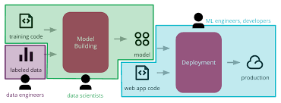
OBJECTIVES
STATE-OF-THE-ART RESULT.
CORRECTION OF ORIENTATION PROBLEM
DEPLOYMENT OF THE MODEL

Slide 6
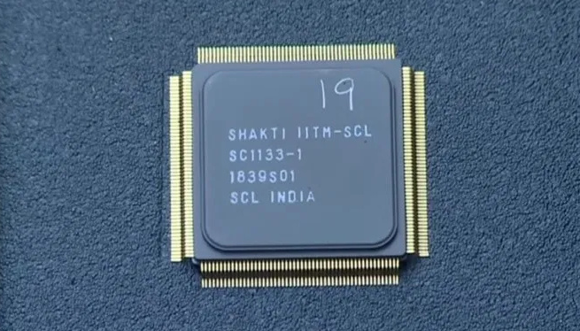
Hardware Specifications
SHAKTI Parashu (E32-A100) on Artix7-100T FPGA
PARASHU is a SoC built around E-class .
Parashu is a 32-bit E-class micro controller with 4 KB of ROM and 256 MB of DDR.
Xilinx Artix-7 technology offers low power consumption and high performance, and its ability to host RISC-V soft architecture makes it ideal for portable equipment.
The Artix-7 can also host the Micro Blaze soft processing system and adapt to multiple project requirements.
Both the 100T (1286-1206-ND) and 35T (1286-1104-ND) options for the Arty A7 board offer the ability to host RISC-V, with 100T offering the most robust and scalable option.

Slide 7
Features
Internal clock speeds exceeding 450 MHz
On‐chip analog‐to‐digital converter (XADC)
Programmable over JTAG and Quad‐SPI Flash
90 DSP slices (35T) and 240 DSP slices (100T)
5,200 slices (35T) and 15,850 slices (100T) containing four 6‐input LUTs and eight flip‐flops
256 MB DDR3L with a 16‐bit bus @ 667 MHz
16 MB quad SPI Flash
Powered from USB or any 7 V to 15 V source
10/100 Mbps Ethernet and USB-UART bridge
Applications
Low-cost ultrasound
Multi-protocol machine-vision cameras
Programmable logic controllers (PLC)
RISC-V controllers/processors
Small form-factor and battery-powered software-defined radios

Slide 8
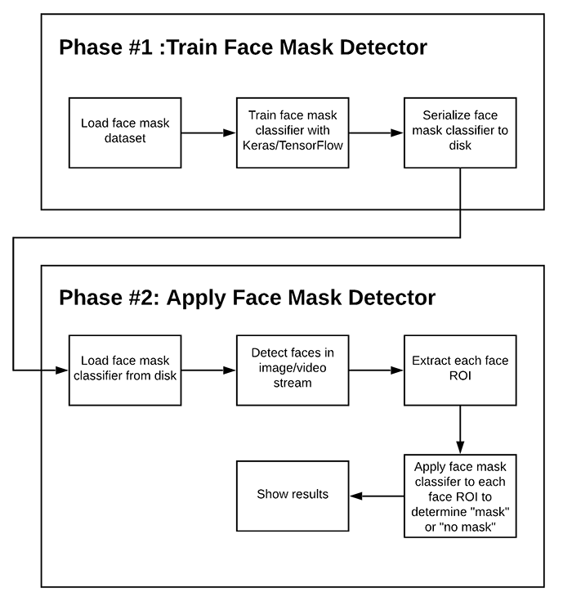
Proposed Architecture
Two phase face mask detector
The complete combined model is then saved as a .h5 file and installed in IP cameras with sensor facilities.
First Phase- Train Face Mask Detector
Second Phase – Apply face mask Detector

Slide 9


CODE SNIPPETS

Slide 10
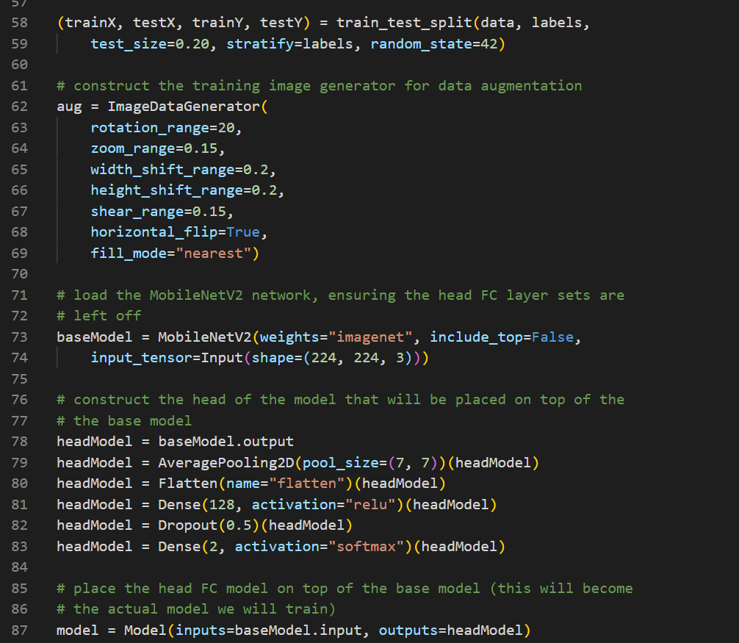

Slide 11
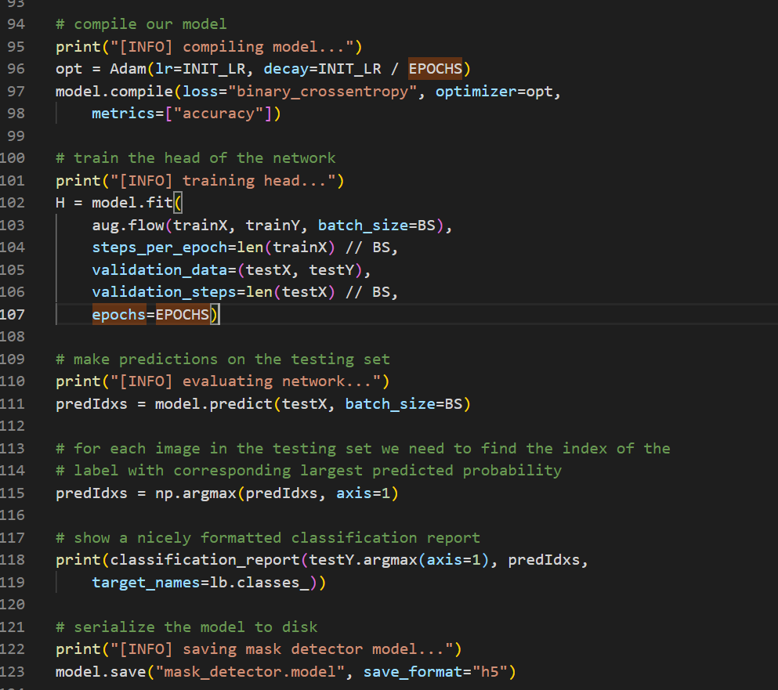

Slide 12
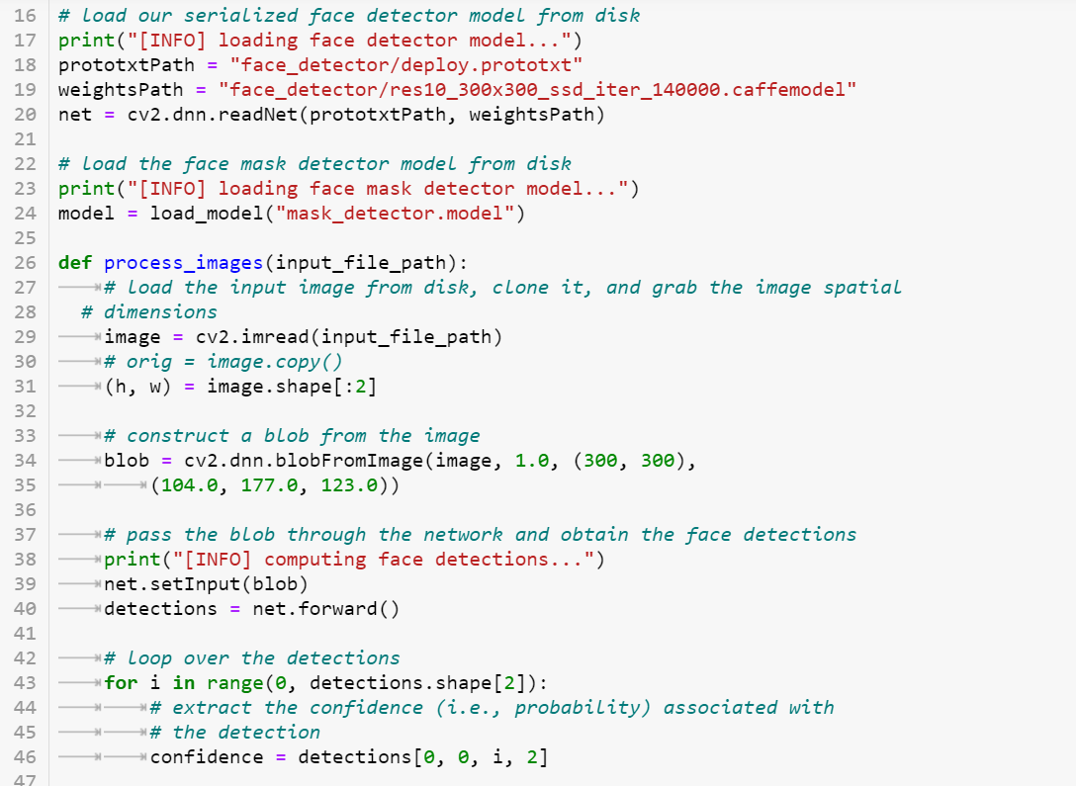

Slide 13
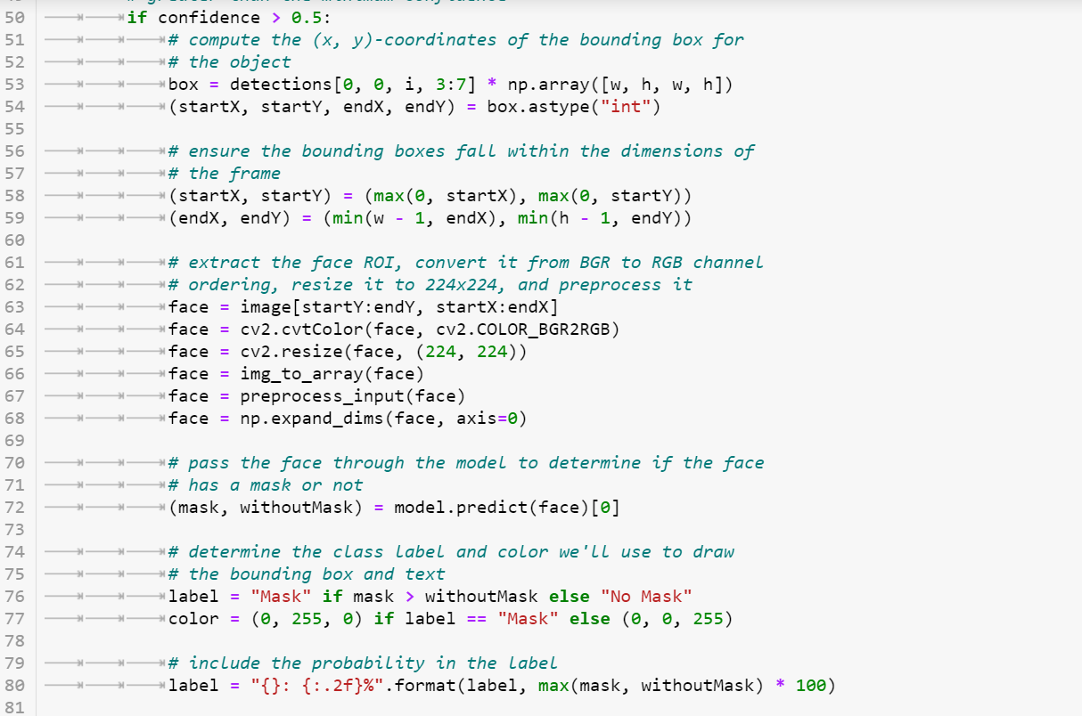

Slide 14
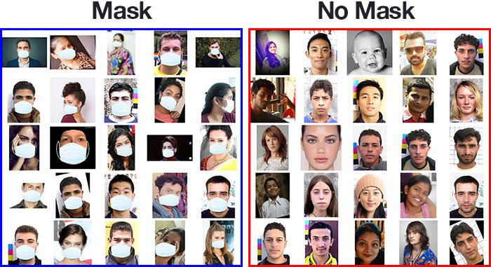
DATASET USED FOR TRAINING

Slide 15
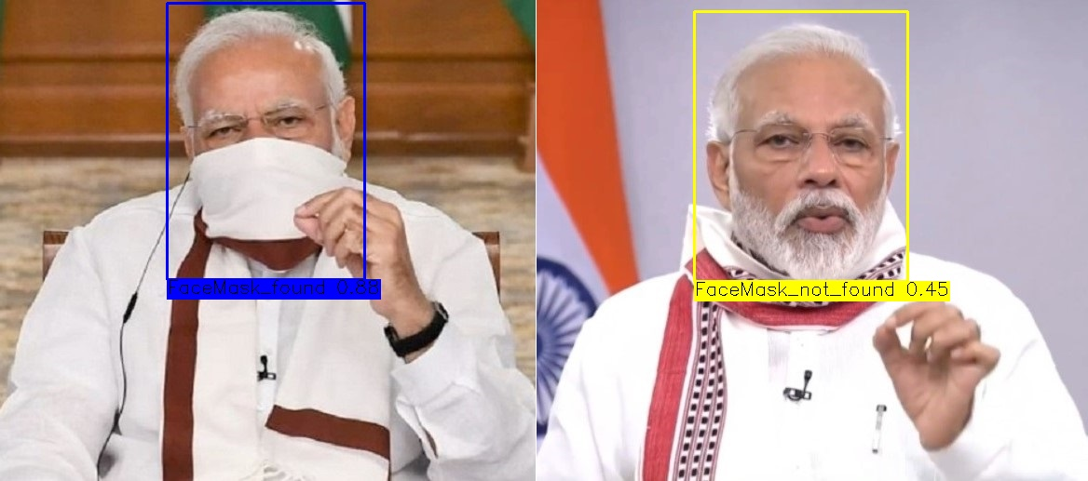

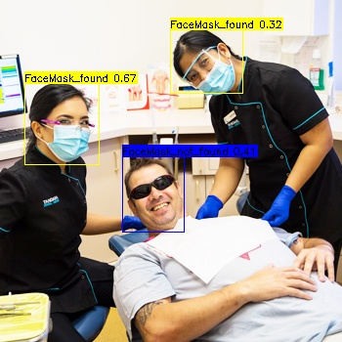

1st Phase OUTPUTS

Slide 16
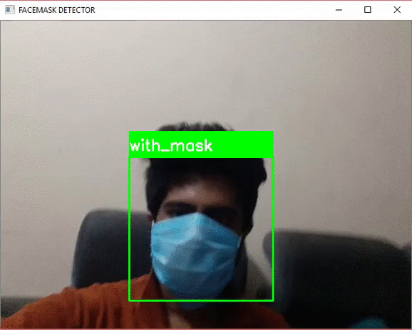
2nd phase OUTPUTS (reference)

Slide 17
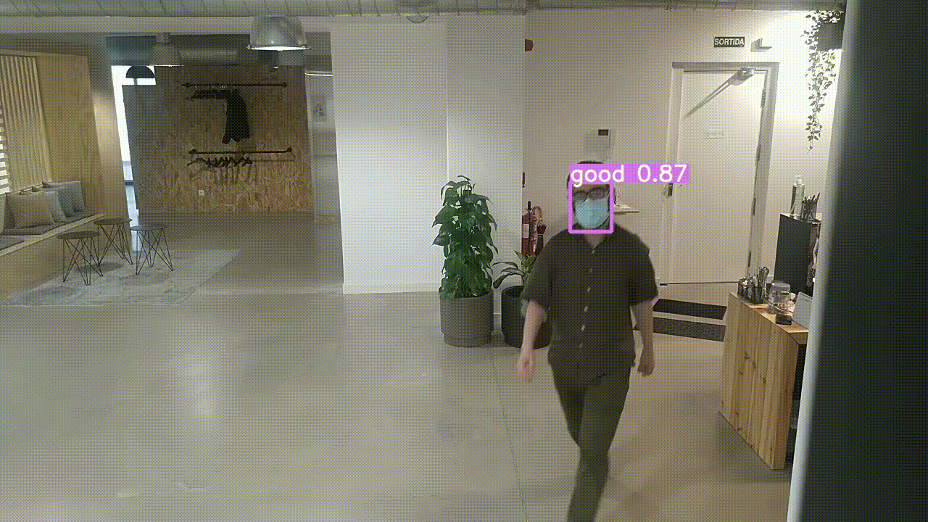
REAL TIME DETECTION(sample)

Slide 18

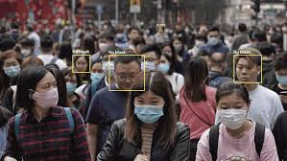
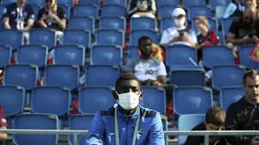
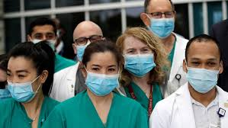
Applications
The system can be used in following areas to identify people with or without masks:

Slide 19
Thank You !!!
Team IIESTS_2
By Sourav Gupta, Hanuman, Ankit Kumar
3rd Year IT Department

